Slide 1

AI BASED FINANCE TRACKER
AI-Based Financial Expense Tracker
School of Computer Science and Engineering
Department of Computer Science and Engineering
Submitted By:
Name : Ananya Sahu
Registration no. : 2427030501
Supervised By:
Name: Dr. Ashish Kumar

Slide 2
Outline
Introduction
Literature Review
Problem Statement
Proposed Solution
Objectives
References

Slide 3
Introduction
AI-Based Financial Expense Tracker
Tracks all your expenses automatically and categorizes them for clarity.
Visualizes spending patterns through interactive charts and graphs.
Uses AI to predict potential overspending and highlight areas to save.
Provides personalized tips to manage money more efficiently.
Helps users make informed financial decisions and build healthier money habits.
Turns budgeting from a stressful task into a simple, smart, and stress-free experience.

Slide 4
Literature Review
1. Traditional expense trackers rely mainly on manual entry and simple categorization.
2. With the advent of AI, predictive analytics can now identify overspending patterns.
3. Studies show that visualization and automated insights improve user engagement.
4. Existing tools lack personalized recommendations based on spending history.

Slide 5
Problem Statement
Most expense tracking systems lack intelligent analysis and predictive insights, making it difficult for users to identify overspending patterns and plan savings effectively.
Most of them only record expenses but do not help users analyse habits, plan savings, or make responsible financial decisions.
Current systems do not encourage responsible habits such as saving regularly, or contributing to social causes.

Slide 6
Proposed Solution
1. Collect and categorize user expenses
2. Visualize spending patterns for monthly insights.
3. Employ predictive models to forecast potential overspending.
4. Provide AI-driven suggestions such as: 'Reduce spending on food to save ₹2,500.'
5. Provide insights on expensed

Slide 7
Objectives
• To develop an intelligent financial dashboard using AI and Python.
• To analyze and visualize monthly spending patterns.
• To predict future expenses using machine learning models.
• To generate actionable insights that help users save money.

Slide 8
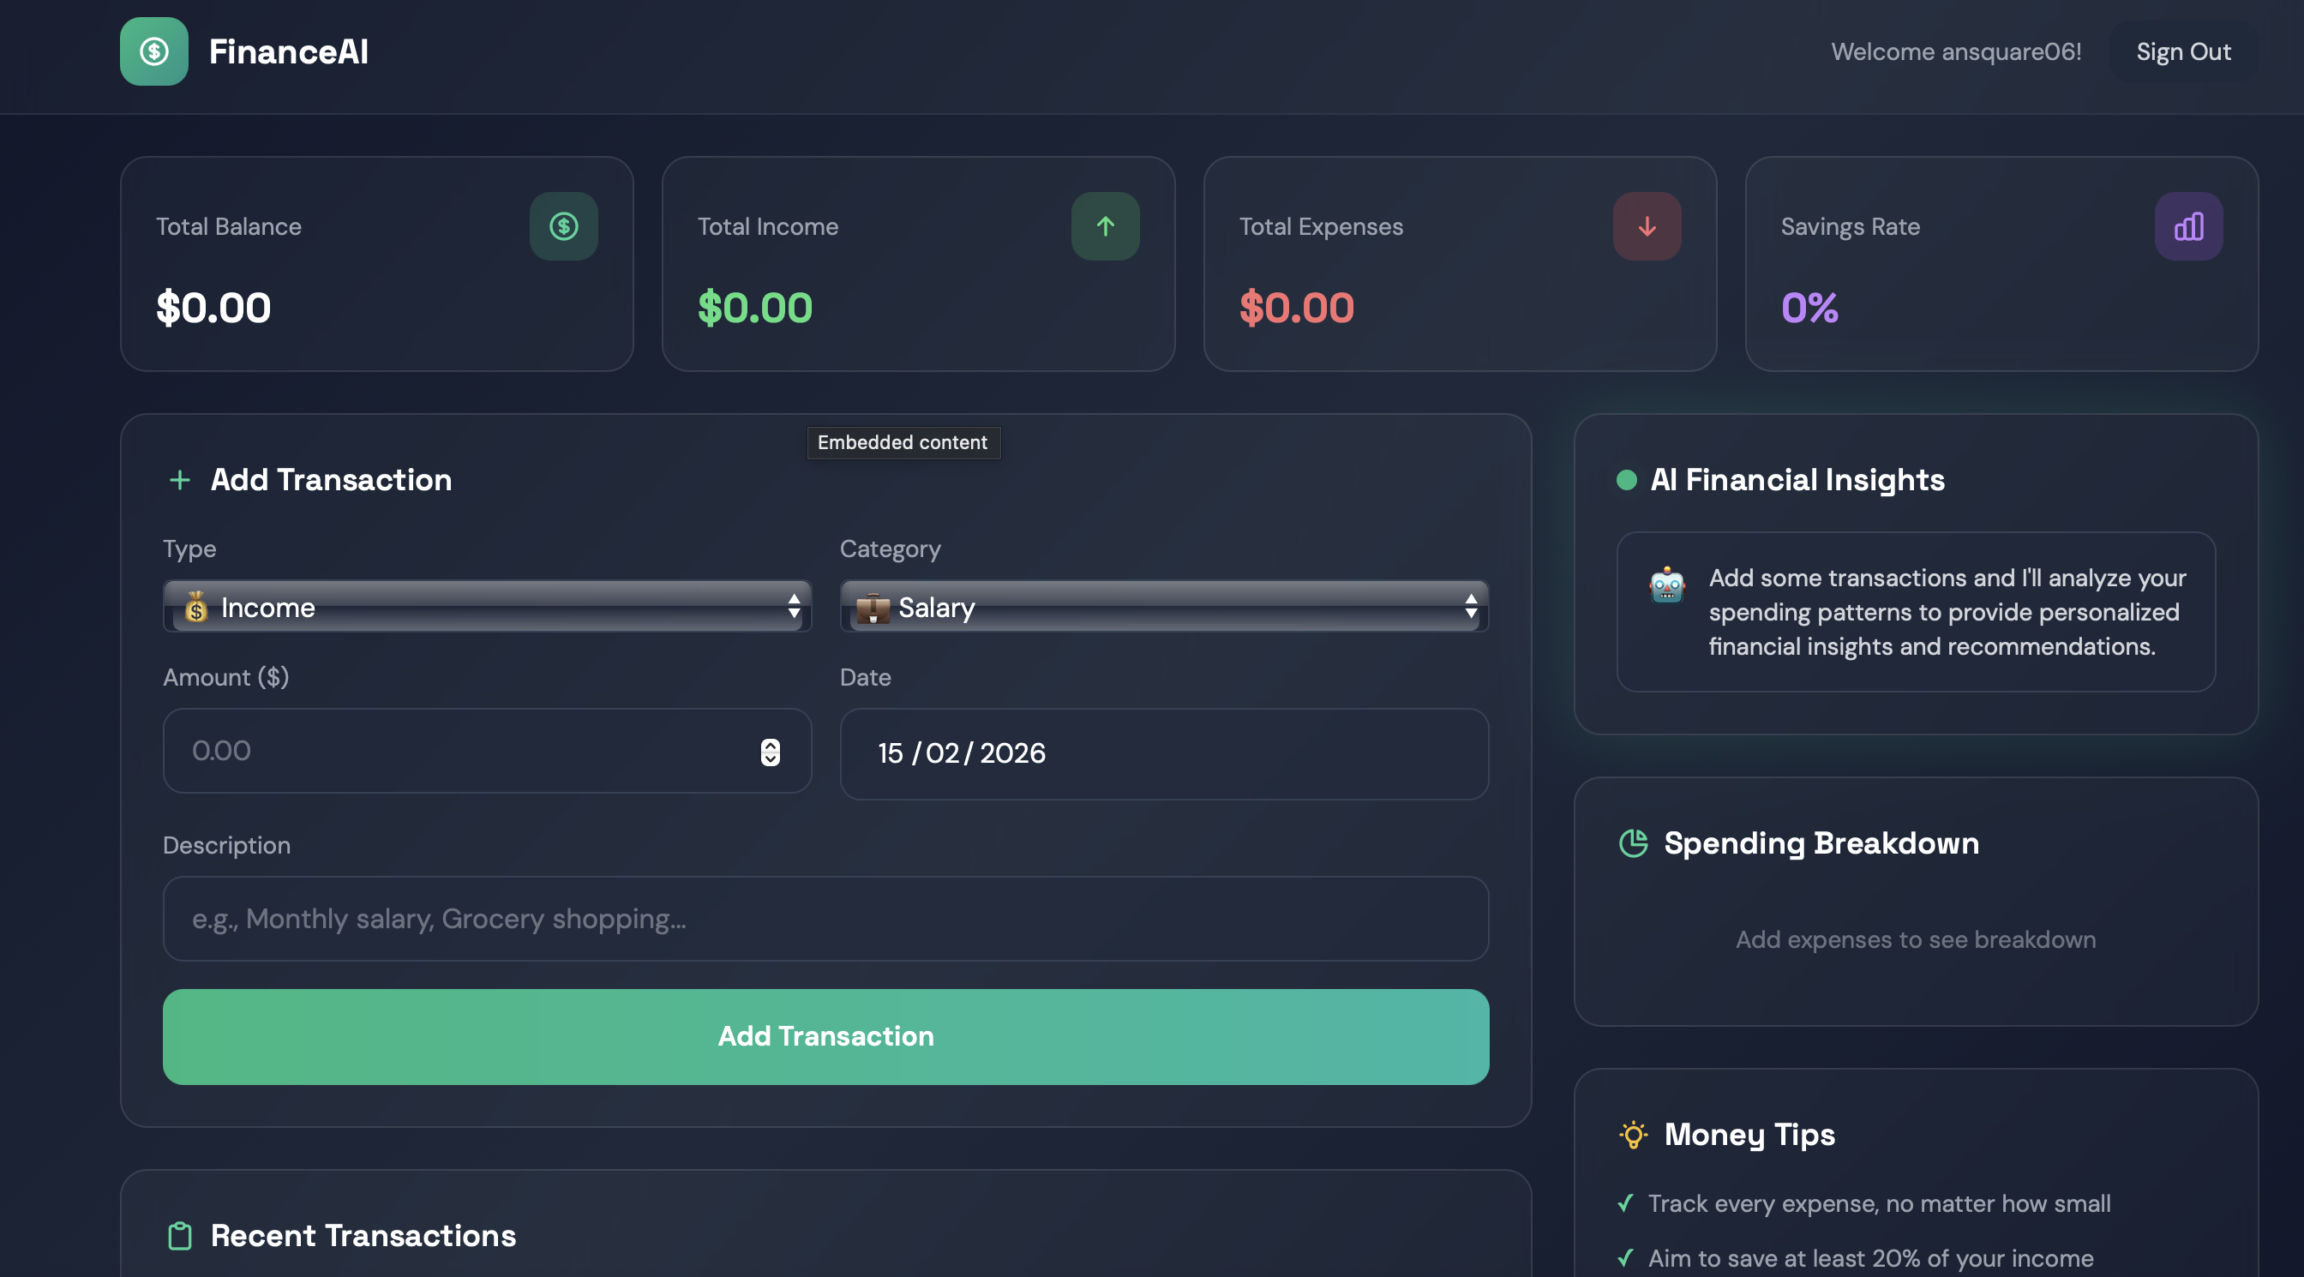

Slide 9
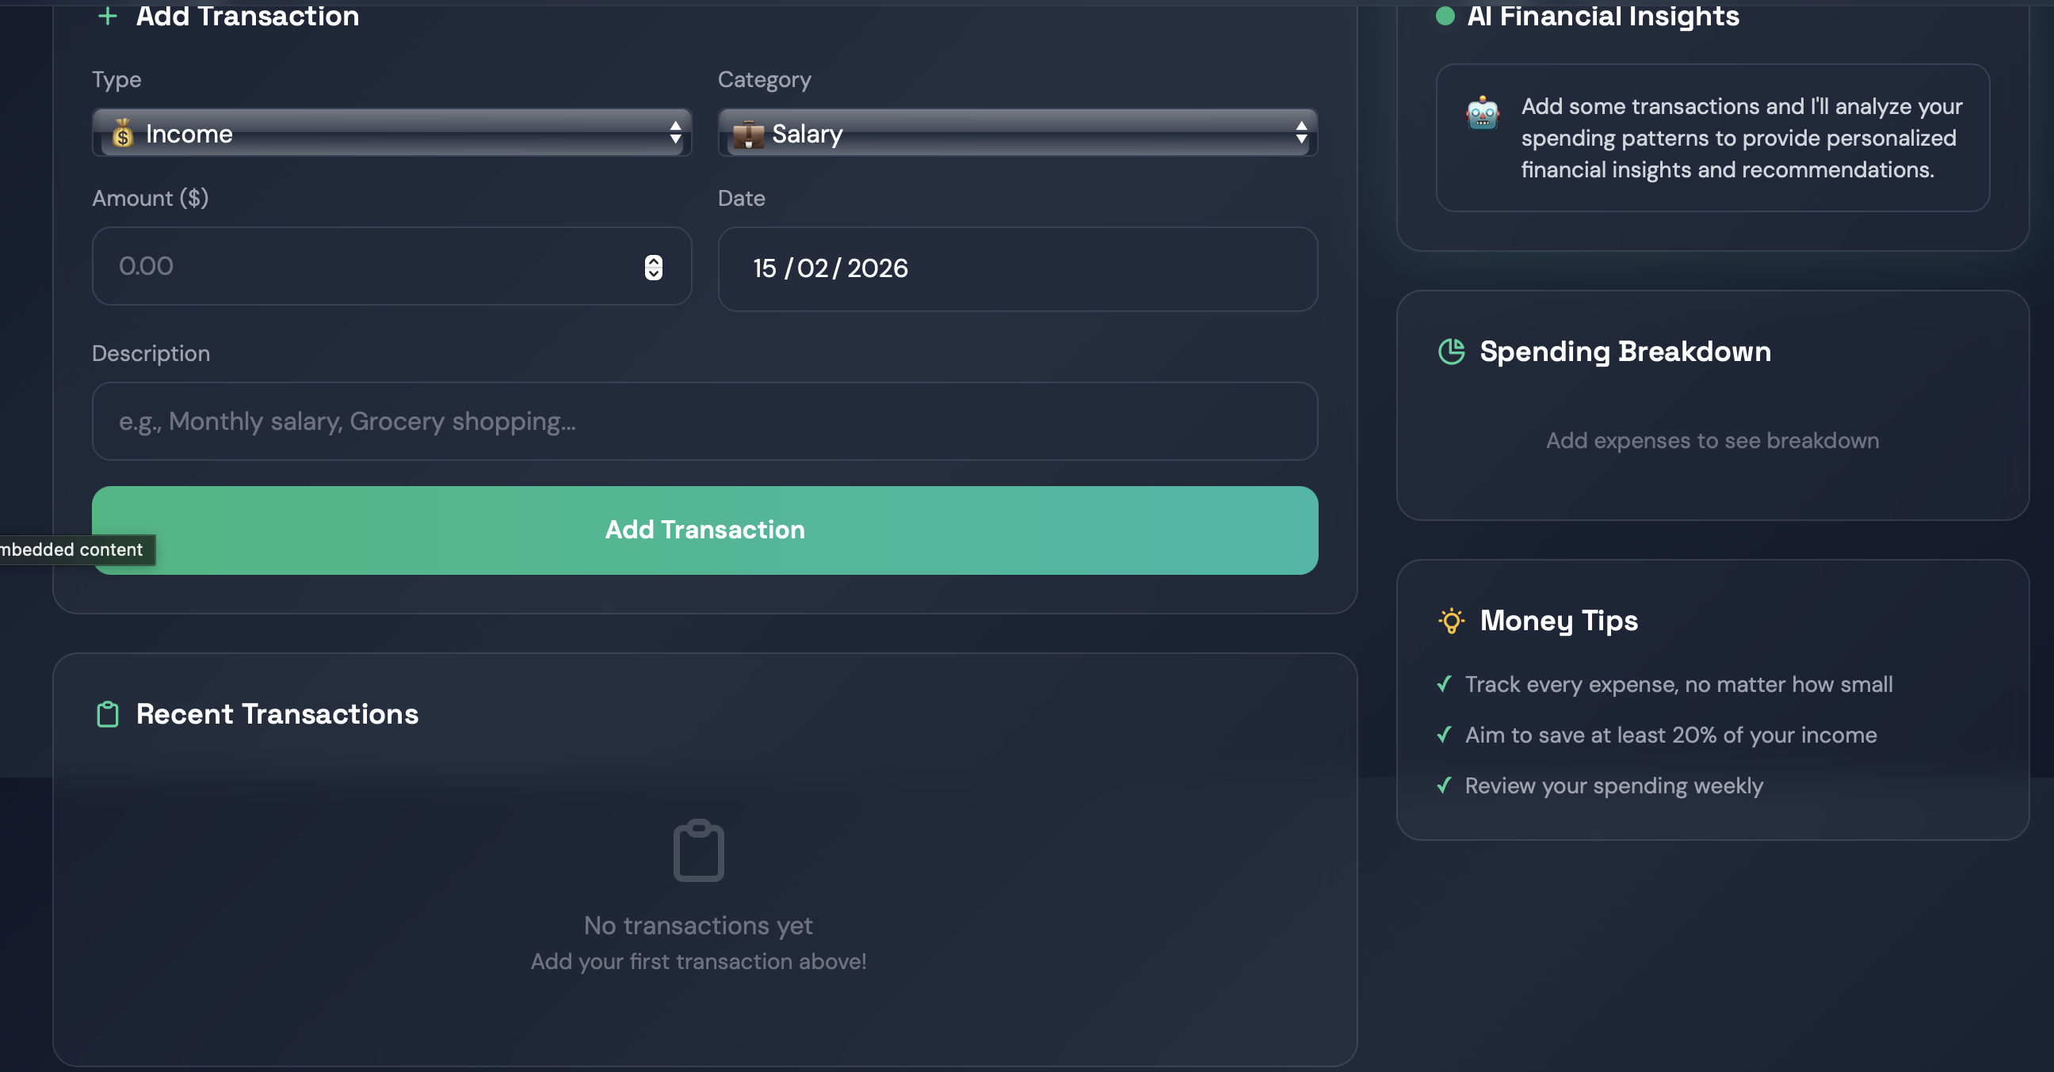

Slide 10
References
Python Data Analysis Library (Pandas) Documentation.
Streamlit Official Documentation.
Scikit-learn Machine Learning Toolkit.
Financial Data Visualization with Matplotlib.

Slide 11
Thank You

